Slide 1
Helping the Homeless with Qiosk
Developed By Hailey Hultquist, Takondwa Kakusa, James Shao, and Cameron West

Slide 2
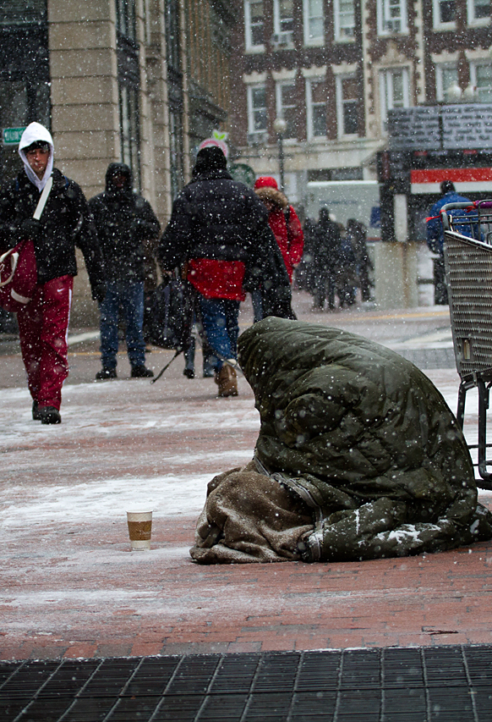
Why We Want to Help
In 2016, there were 550,000 Americans that were homeless.
Los Angeles and San Diego have the 2nd and 4th highest homeless populations in the nation.
California accounts for 28% of all homeless population.
Homelessness is mostly caused by a lack of steady income and a severe lack of affordable housing.

Slide 3
What We Aim To Do
Provide accessible, easy-to-use technology for the homeless and underserved to search for jobs.
Helps to build wealth and reputation.
Provide an Uber-esque review system that allows employers and employees to give ratings on a per job basis.
Providing underserved populations information on resources such as financial services, job fairs, community events, hygiene locations, etc.

Slide 4
Demo

Slide 5
Our Team Structure
Backend Server:
Takondwa Kakusa
Website / UI Design
James Shao
Cameron West
Android App Development
Hailey Hultquist

Slide 6
Our Implementation
Backend
Used Django framework which utilizes an SQLite database.
Frontend
Used the Foundation framework with jQuery and Sass styling.
Android Development
Developed in Android Studio to create a prototype app.
Embedded Devices
Researched ability to use DragonBoard to serve as the Qiosk main computer and to provide facial recognition services.

Slide 7
Our Future Vision
Bring Qiosks to metropolitan areas that have the greatest homelessness population.
Work with local businesses to build confidence in hiring those with little to no skill.
Implement DragonBoard to be the low-cost computer behind the Qiosk.
Implement LTE for remote internet access.
Hold community events to hire low-skilled labor and build reputation.

Slide 8
References
https://www.nlchp.org/documents/Homeless_Stats_Fact_Sheet
https://www.forbes.com/sites/niallmccarthy/2016/11/25/the-u-s-cities-where-the-largest-homeless-pop-infographic/#1dc344c24dde
http://host.madison.com/wsj/news/special/homeless/introducing-the-series-a-challenge-to-move-beyond-stereotypes-and/article_372866d7-3bb9-5690-87e2-1c98b8f58995.html

